Slide 1


Mental Trauma : A Sentiment Analysis based on Locality during the Covid-19 Breakout
Nate Reedel
Github https://github.com/NReedel/OESON/tree/main/Final

Slide 2
Description
Info
Given the real data of tweets collected during the outbreak of Covid-19 disease. The perception of the disease played an important role in providing psychological care to individuals where negative sentiments influenced people’s psychological health.
Goal
To perform a sentiment analysis of the collected tweets to find which parts of the world were affected the most by mental trauma.
Provide a real time analysis of the situation so that these parts can be reached in future in advance if there is any outbreak of a mass disease.

Slide 3
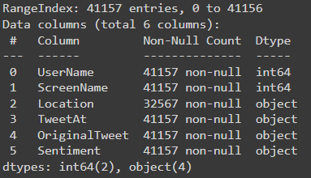



Data Table
The spreadsheet of Corona data provides 6 fields with 41,157 entries provided with real data during the 2019 outbreak of Corona.
Since the goal is to find the sentiment of tweets based on location, we won’t use the original tweets themself but rather the locations they originated from as to get a consensus of the tweet respective sentiment whilst processing an entry.

Slide 4
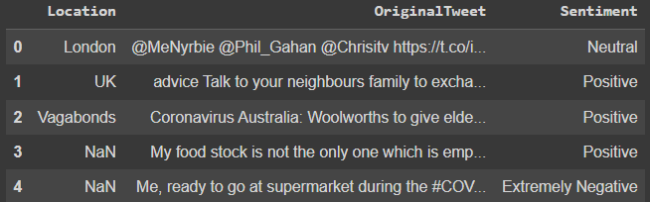

Sample
This sample is the first 5 records of Original Tweets with the Location and Sentiments values to be used.
There is a plethora of locations though some entries won’t provide info for the analysis.
Sentiment has 5 categories of possible values. 'Extremely Negative’, 'Negative' 'Neutral’. 'Positive' 'Extremely Positive’.
For the sake of the sentiment analysis these will be scaled and enumarted, representing values 0 (Extremely Negative) to 4 (Extremely Positive) respectively.

Slide 5

Sentiment Analysis
Using a Recurrent Neural Network (RNN), the collection of tweets can provide an overall sentiment for a given local in the world, so long as the input terminology for the model matches an entry in the location field.
RNN - a deep learning model trained to process and convert sequential data.

Slide 6

The Predictive Model
By running the name of varies affected countries through the model, a sentiment can be made.
Since the sentiments have a series of 5 categories. I based the mental health value on the enumeration of the predicted sentiment.
Here are the results…
This Photo by Unknown Author is licensed under CC BY-NC

Slide 7
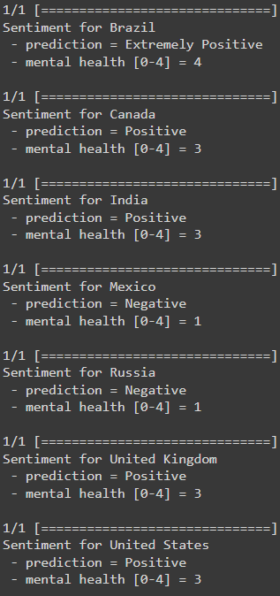
Country Entry Results
Of Brazil, Canada, India. Mexico, Russia, United Kingdom, and United States. This can be said…
Most Countries scored above a 2 or Neutral value, indicating decent mental health during the outbreak for at least the selected sample.
Mexico & Russia had negative values which where, in this case, the worst mental health values of the lot, sitting at a 1 of 4 ranking.

Slide 8
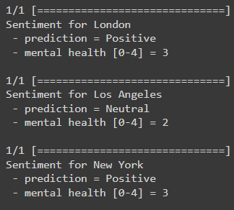
City by Comparison
Though there where not as many city options as countries available the ‘location’ data entries still included both.
The United States and United Kingdom had the same sentiment, as provided from the previous slide. Data was be provided from some cities residing in them.
Comparison
The United Kingdom scored Positive on mental health, by comparison...
London scored the same as the United Kingdom and so reflect the sentiment of its own country.
The United State scored Positive on mental health, by comparison…
Los Angeles Scored a Neutral value.
New York was also Positive

Slide 9
real time analysis for future reference
Russia and Mexico according to twitter had the worst time with the Covid-19 outbreak. This indicates they need the most help as they appear to have handled the situation with a poor mentality based on trauma.
In America, Los Angeles had a greater issue with the virus, more so than New York or the rest of the United States. Los Angeles would be the first major city in America to reach out to and prepare in case of similar occurrences.

Slide 10
Some Issue
Test Loss
Though the accuracy for the model was fine, the test loss was relatively high and difficult to fix for the data table. I tried remedying this issue with fine-tuning hyperparameters as well as adding optimizers but with little success, so I scraped them from the model and worked the best with what was available.
Cause
The problem lies in the data quality, for the locations field of tweets had several issues that where hard to rectify based on the content of the data column. These include…
Missing Values: In this case values were filled with ‘NaN’ instead of being just blank. This made it impossible to use a fill to help fix it. Such an issue can disrupt the training process leading to high test loss.
Data Imbalance: One location may have significantly fewer samples than others. This is hard to identify based on the large data sample and therefore was problematic.
Noisy Data: Some data contains irrelevant or misleading information, which can confuse the model. Occurrence of this could be seen in some entries.

Slide 11

Conclusion
The sentiment analysis provided some useful information using easily accessible data as to determine an appropriate response in a case of emergency. Though this analysis only uses a small set of locations, it still shows insightful knowledge on a population's mentality during a traumatic experience.
Further improvements on data and the model as well as greater samples could make this predictive technique a go to for decision making on how we choice to act to future trauma, since knowing is at least half the battle.
This Photo by Unknown Author is licensed under CC BY-SA-NC

